Slide 1

Self Driving Car Using Raspberry Pi
Presented by
Sanjay S K
Supriya G K
Pranathi S

Slide 2
1.Hardware Components
Raspberry Pi 4 .
Camera
Ultrasonic Sensors (2)
Wires.
L293 Motor Driver.
DC Motors (4).
Chassis Kit.

Slide 3
2.Software Components
Raspberry PI OS
Python 3
Libraries
CV2
Numpy
RPi GPIO
Time

Slide 4
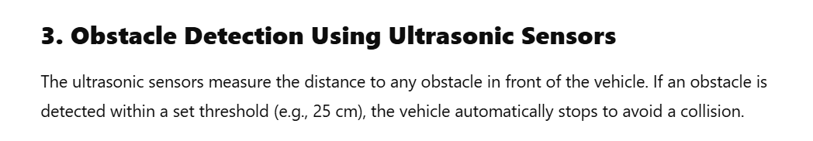
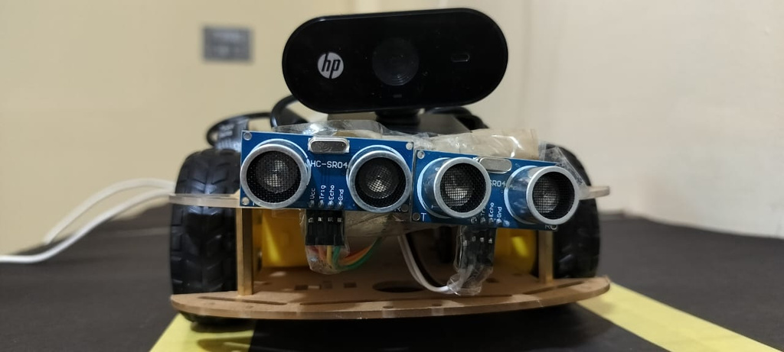
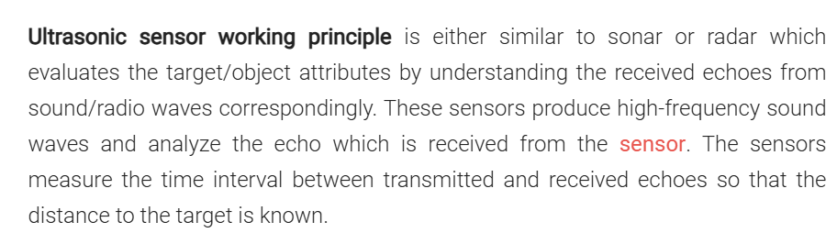
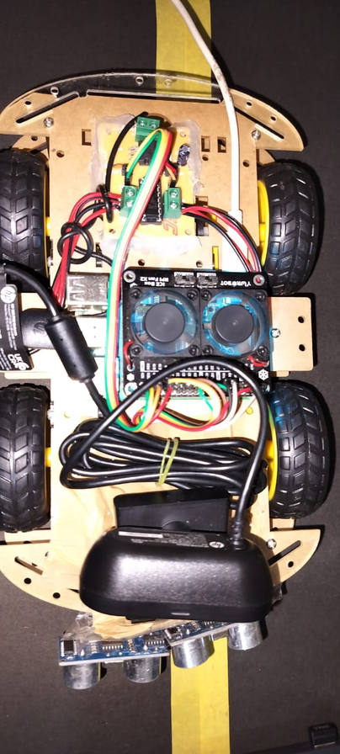
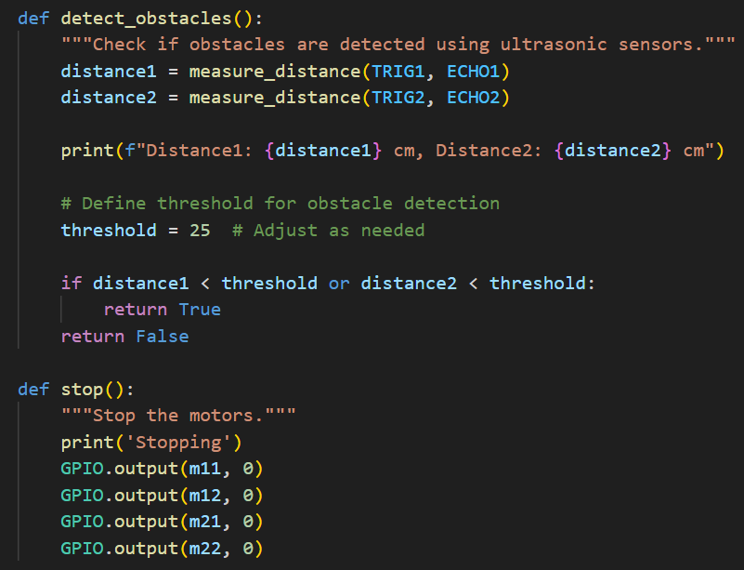

Slide 5
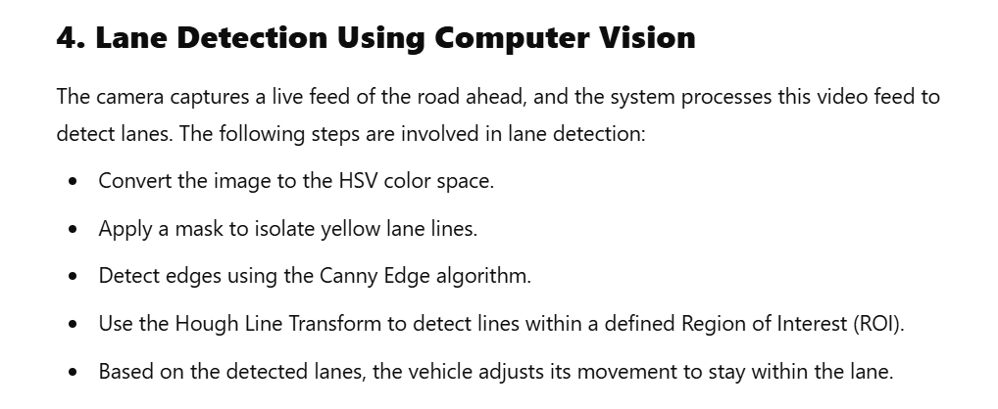
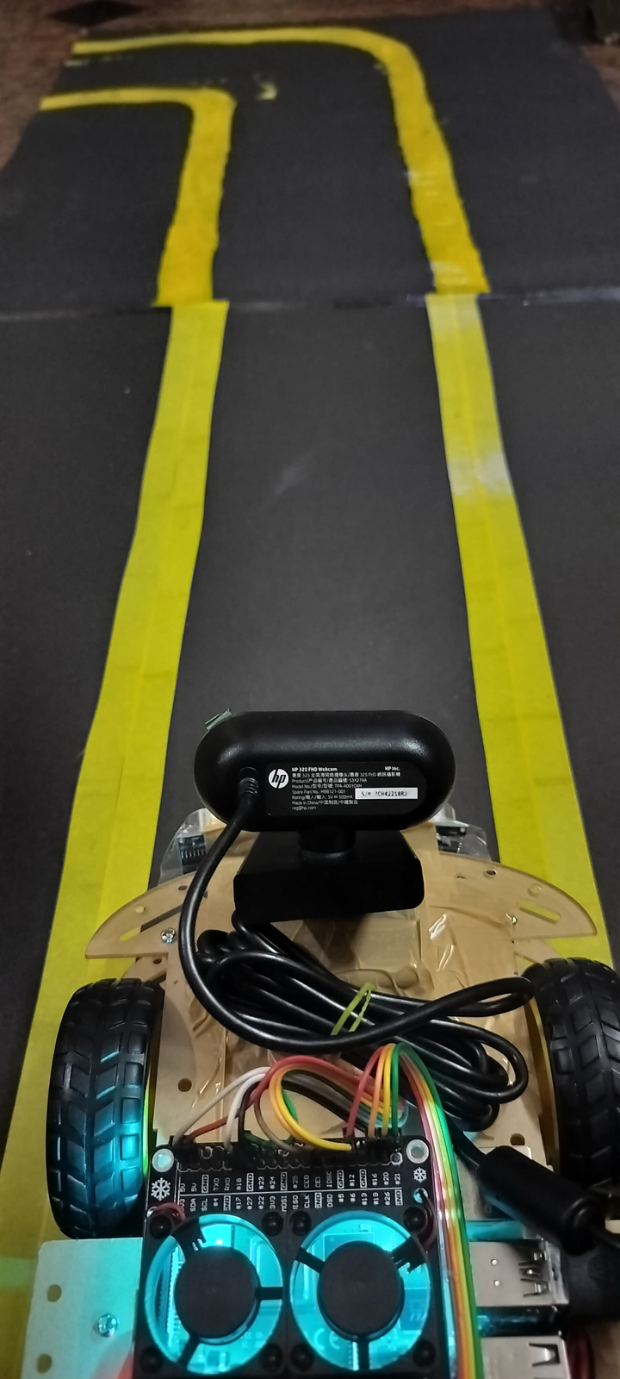

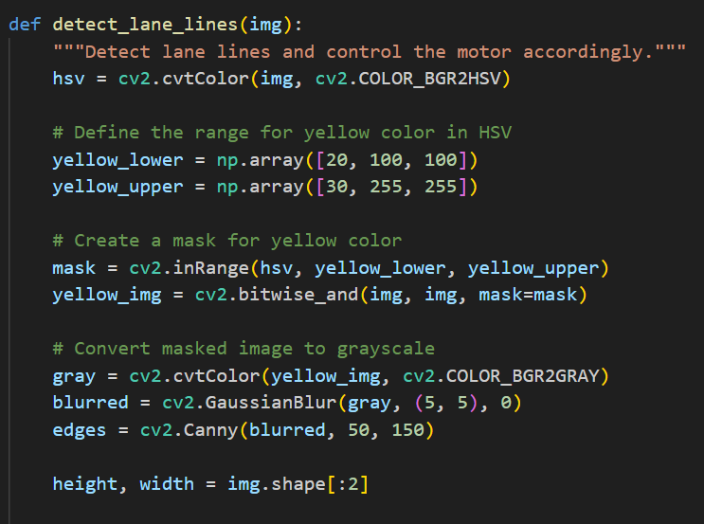

Slide 6
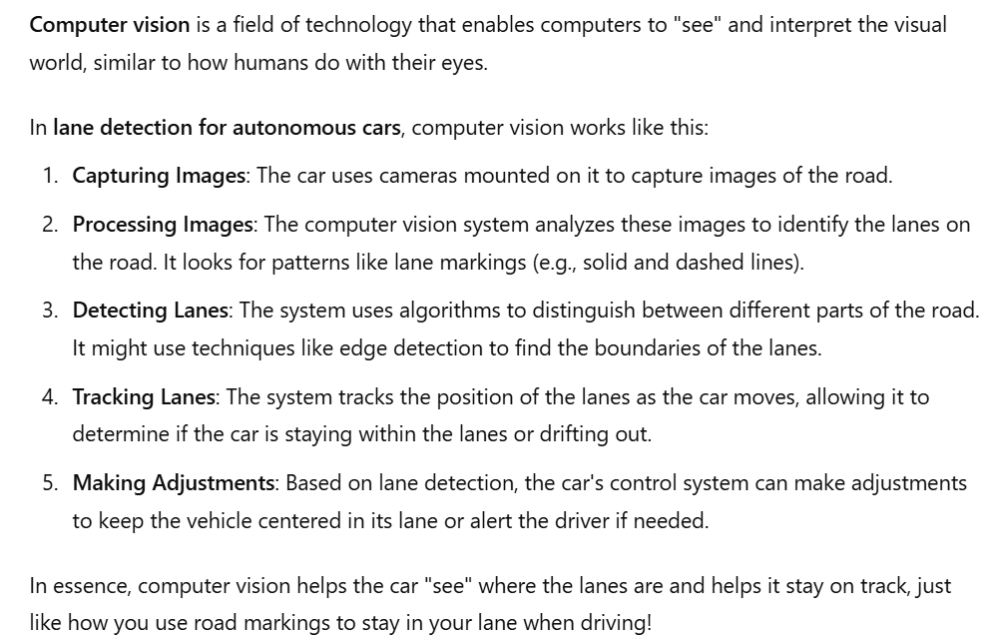

Slide 7
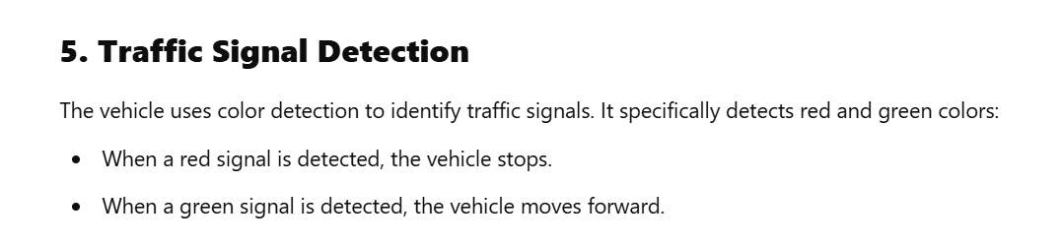
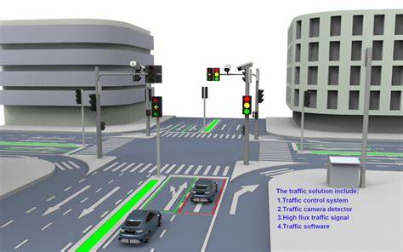
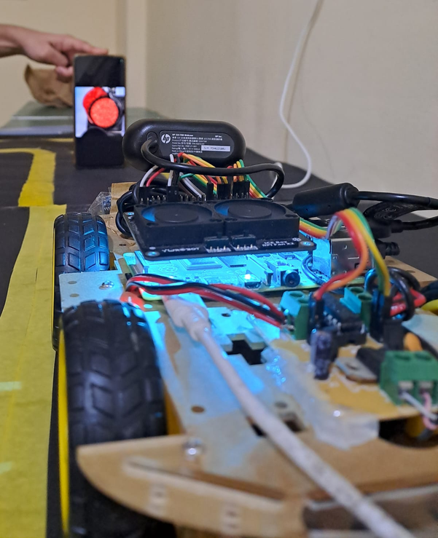

Slide 8
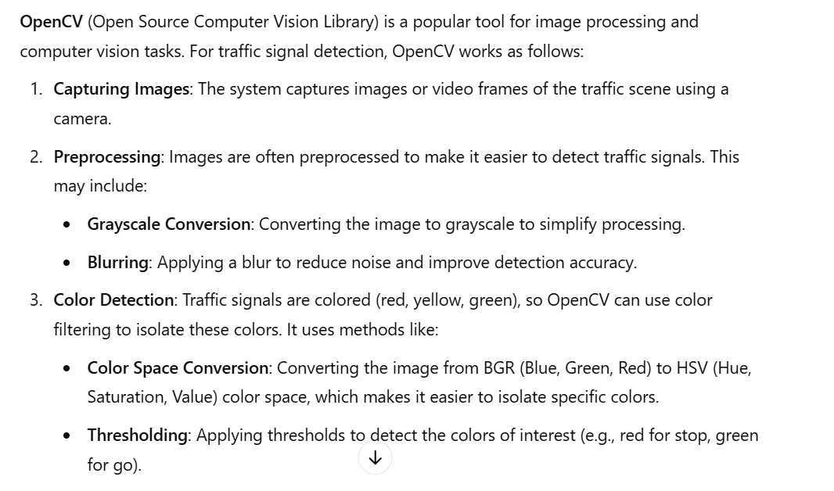

Slide 9
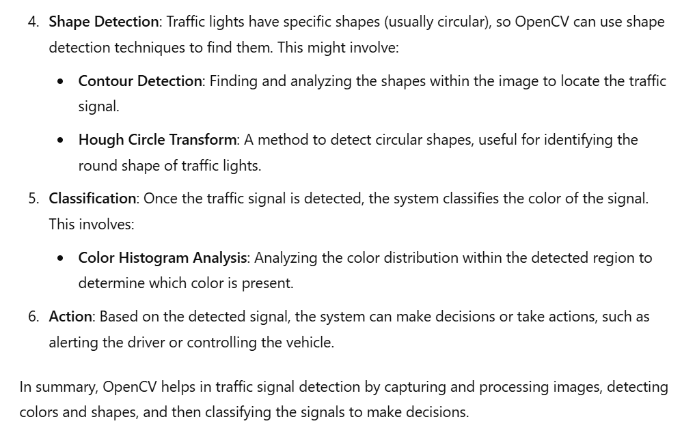

Slide 10
References
Self-driving-Car-Using-Raspberry-Pi/detect_lane.py at master · ishanambike/Self-driving-Car-Using-Raspberry-Pi (github.com)
ChatGPT

Slide 11


